Slide 1
ECG BLE Mechanical Requirement
09-April-2020

Slide 2
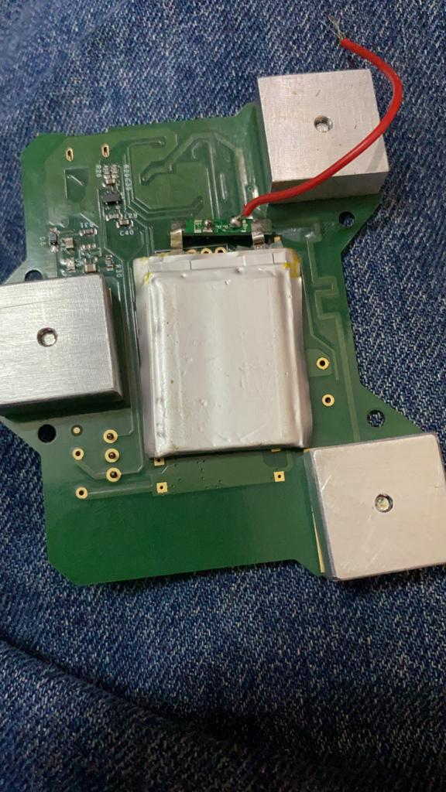
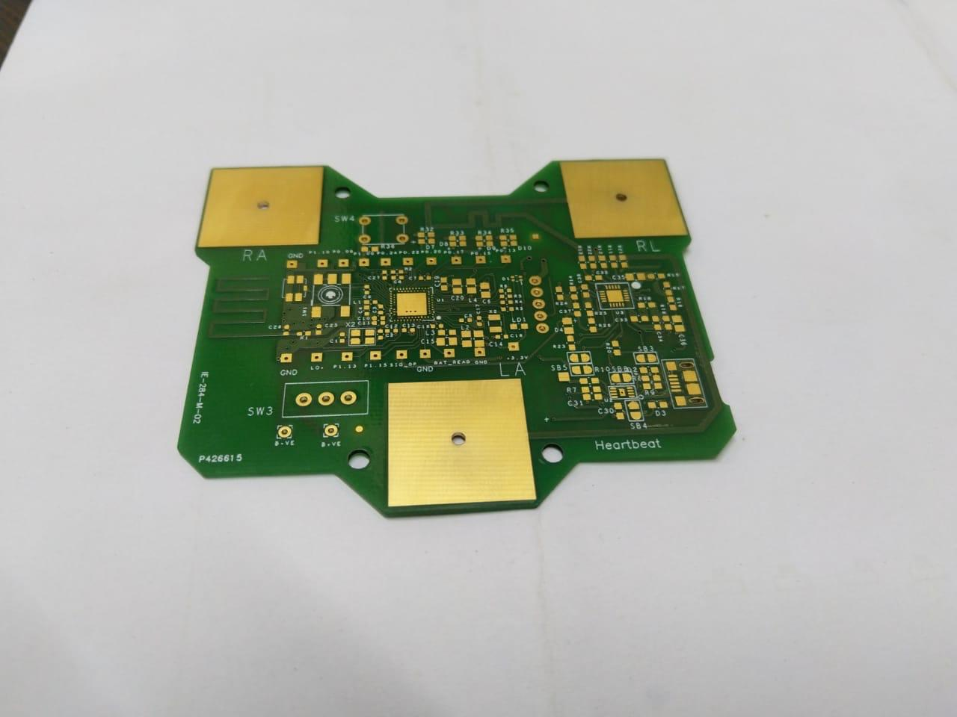
Old board design
PCB Bottom
PCB Top

Slide 3
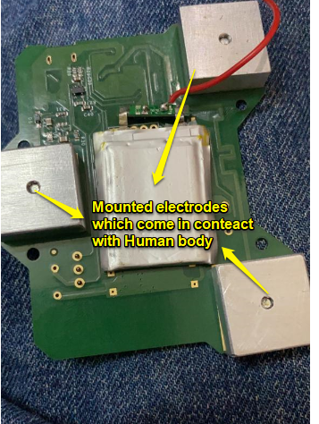
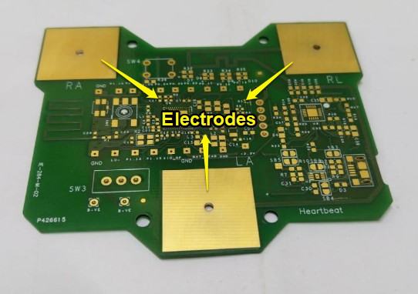
Old board design

Slide 4
New board requirement
PCB Diameter 42mm

Slide 5
New board requirement
Note: Temperature sensor to be added and yet to plan
on the position.
PCB Diameter 42mm
Opening required for casing in
The dotted areas

Slide 6
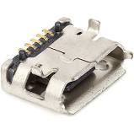
New board requirement
PCB Diameter 42mm
Opening for Micro B USB
Connector
Note: Yet to decide on USB connector position

Slide 7
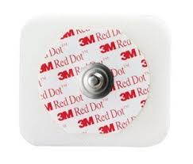
New board requirement
PCB Diameter 42mm
3 Electrodes will be mounted in
the dotted region.
Something similar to this.
Note: Yet to decide the electrode part

Slide 8

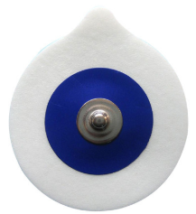
New board requirement
Bottom view
PCB
On board connector
PCB mount
Mating electrode
Note: Yet to decide the electrode part

Slide 9


New board requirement
Bottom view with no electrode mounted
Bottom view with electrode mounted
LA
LA
RA
RA
RL/LL
Over all product looks like a Shoe
Polish tin. Something like this with
the electrode stickers, which will
have contact with Human body.
RL/LL

